Slide 1

ENERGY EFFICIENCY OF BUILDINGS Advanced Statistical Learning - I Group 8 INSTRUCTOR: Prof. CHING CHI YANG
By:
DUNDI SANDEEP DADDALA – ddaddala@memphis.edu
SAI MEGHANA DEVARASETTY – sdvrstty@memphis.edu
NAGENDRA VARAPRASAD BATHULA -n.bathula@memphis.edu
SURYA TEJA MADDILI– smaddili@memphis.edu
MOHAN DUTT UPPUTURI – mpputuri@memphis.edu

Slide 2

CONTENTS
Introduction
Dataset
Data Preprocessing
Data Visualization
Model building
Results
Discussion
Conclusion

Slide 3

INTRODUCTION
AIM: Our team aims to create a predictive model using the ENB2012 dataset. This model will estimate the energy consumption of a building (Heating Load Y1) based on several key building characteristics. while excluding cooling load (Y2).
Key Points:
Objective: Develop a predictive model for heating load.
Importance: Essential for optimizing building design and reducing energy consumption.
Broader Impact: Supports sustainable architecture, urban planning, and energy policies.
Dataset Overview: 768 samples with 8 features, including wall area, glazing area, and overall height.
By concentrating on heating load predictions, this project contributes to the creation of energy-efficient buildings and aligns with sustainable development goals.

Slide 4

DATASET
Sample Size: 768 buildings
Input Variables (8):
X1: Relative Compactness
X2: Surface Area
X3: Wall Area
X4: Roof Area
X5: Overall Height
X6: Orientation
X7: Glazing Area
X8: Glazing Area Distribution
Output Variables (2):
Y1: Heating Load (target)
Y2: Cooling Load (excluded from analysis)

Slide 5
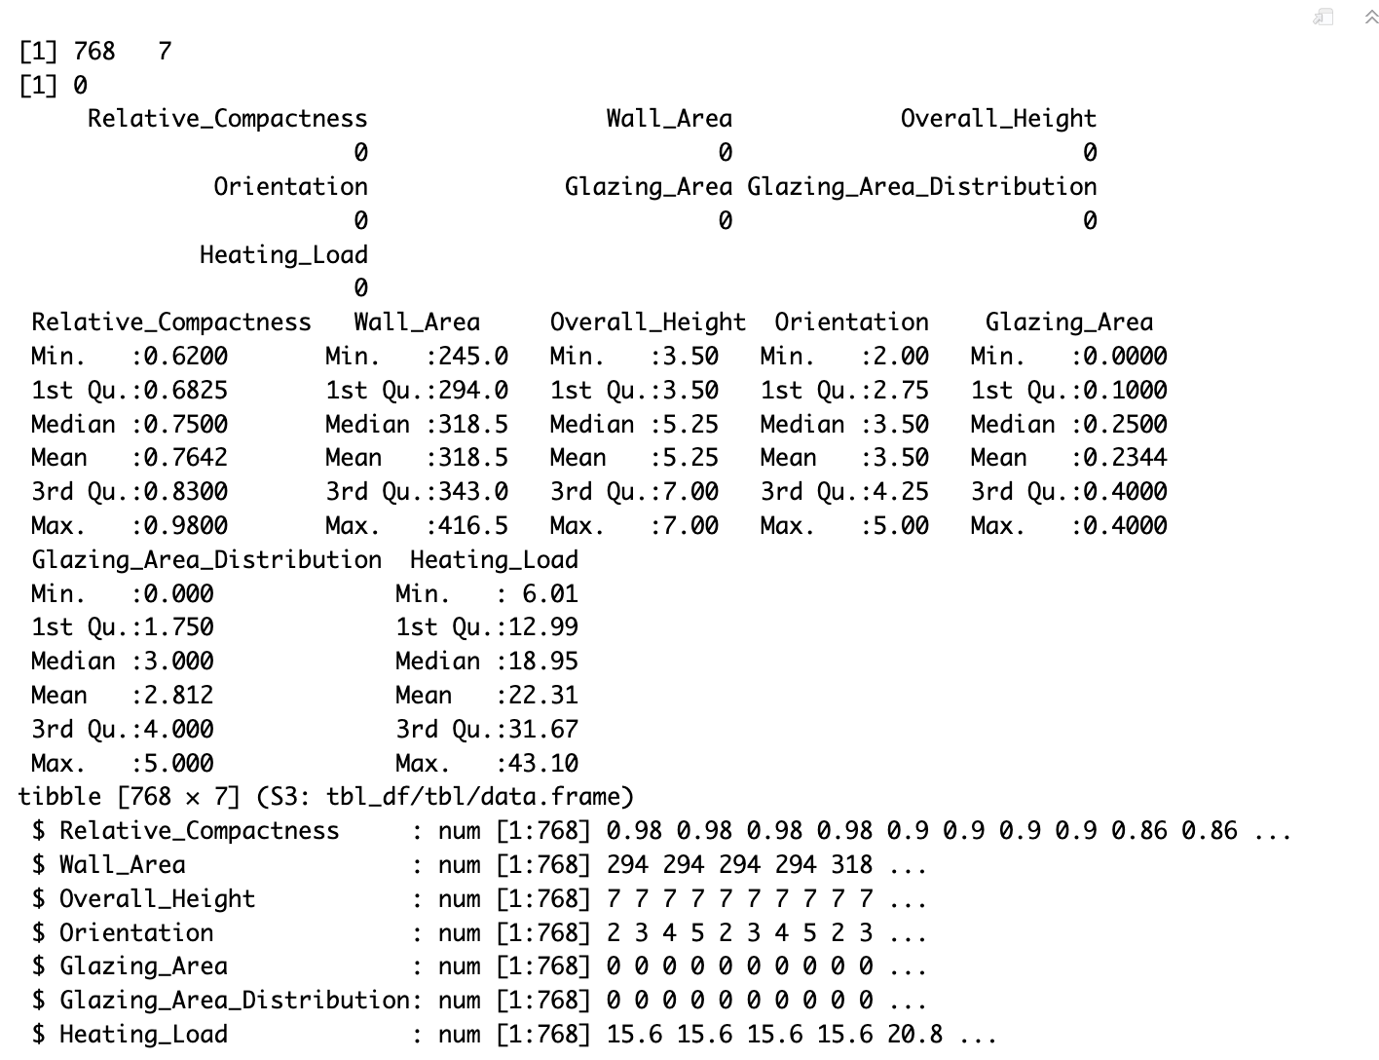
DATA PREPROCESSING

Slide 6
DATA VISUALIZATION
Histogram
Box Plot
Scatter Plot
Pair Plot
Correlation

Slide 7
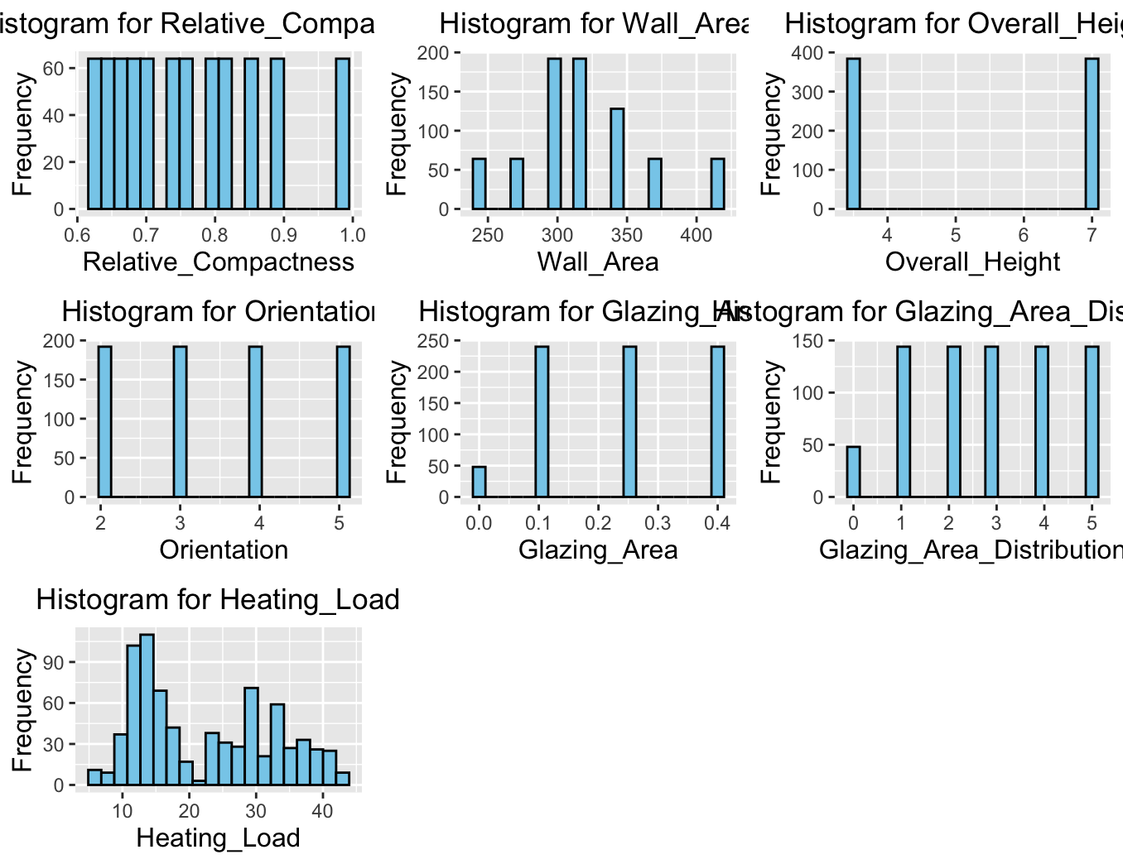
HISTOGRAM

Slide 8
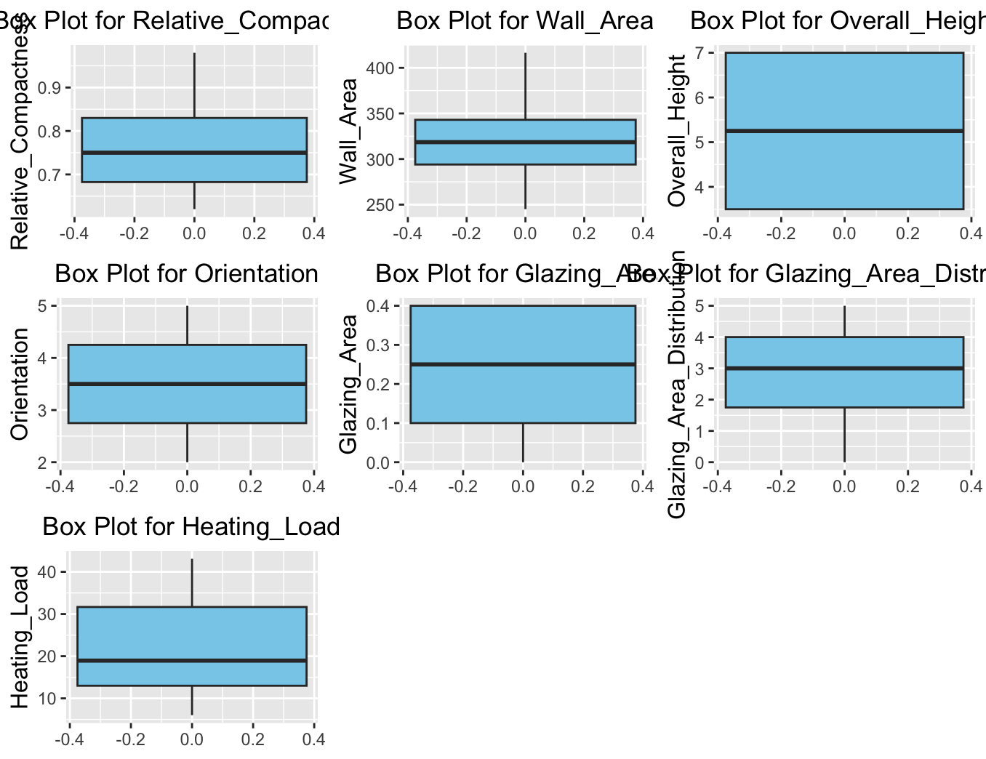
Box Plot

Slide 9
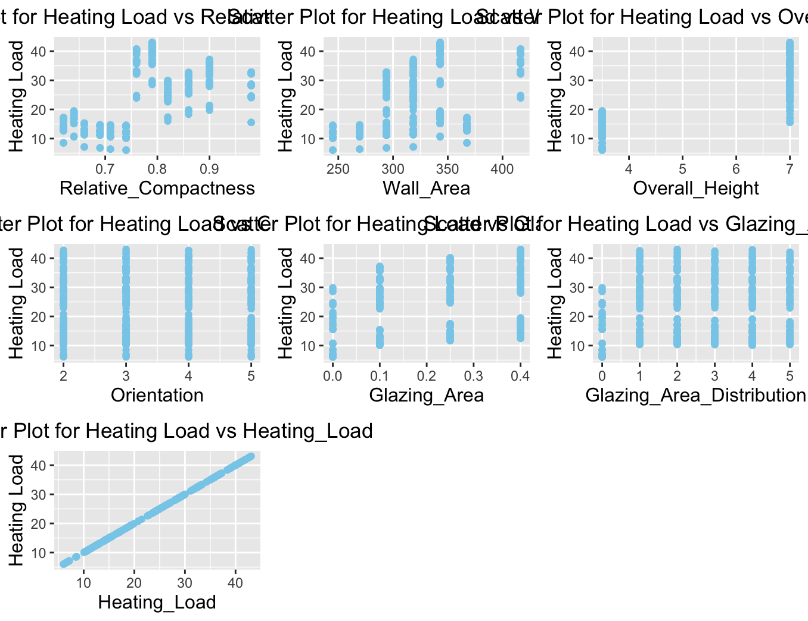
SCATTER PLOT

Slide 10
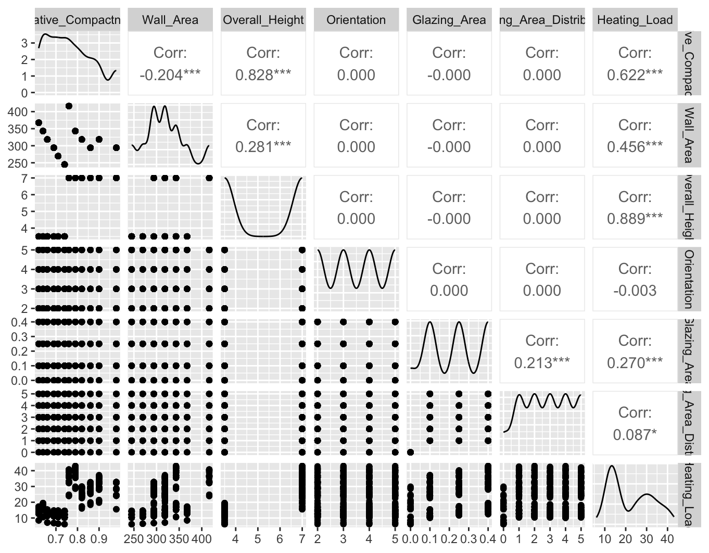
PAIR PLOT
The pair plot reveals correlations between building characteristics and heating load. Overall Height and Wall Area show strong positive correlations (0.889 and 0.456) with heating load. Relative Compactness shows a negative correlation(-0.204). Orientation, Glazing Area, and Glazing Area Distribution show minimal correlations (near 0) with heating load

Slide 11
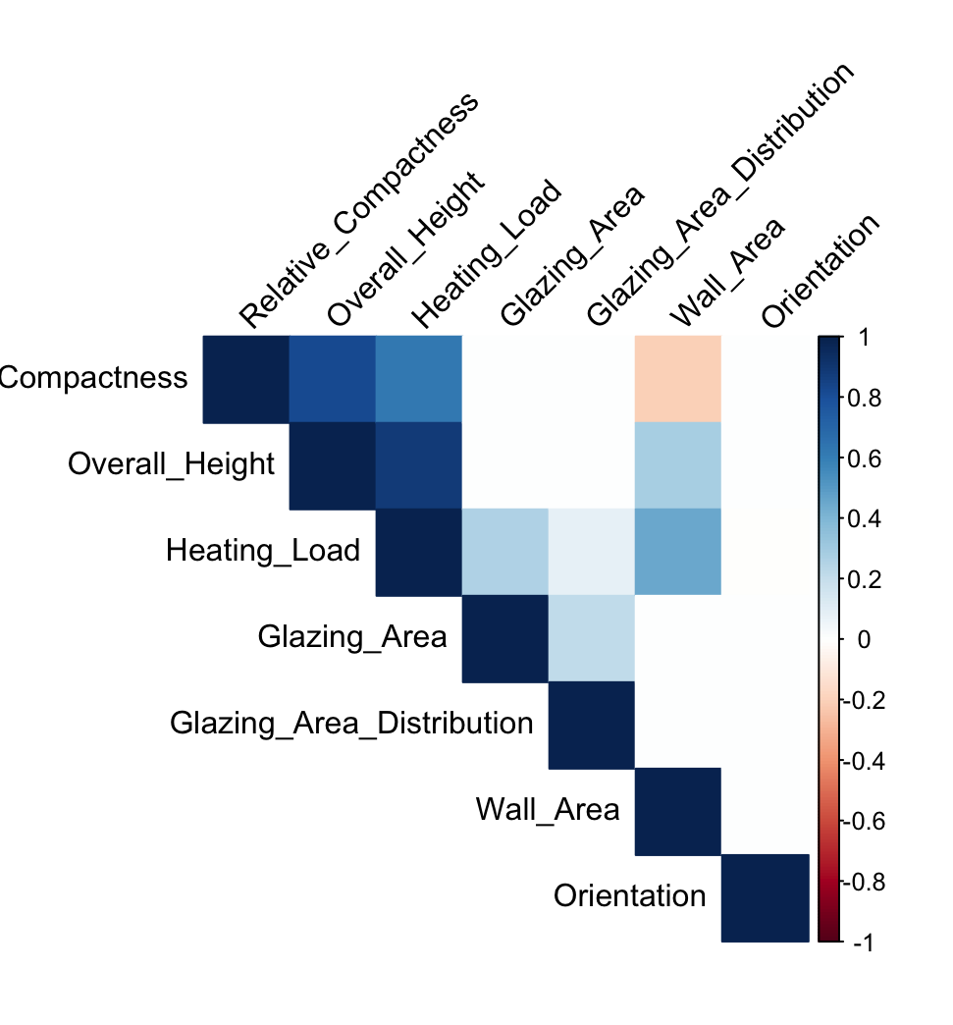
CORRELATION MATRIX
Strong Positive Correlations:
Overall Height and Heating Load (0.889): Taller buildings tend to have higher heating loads
Wall Area and Heating Load (0.456): Larger wall areas correspond to increased heating requirements
Glazing Area and Heating Load (0.270): More window area leads to higher heating needs
Weak or No Correlations:
Relative Compactness and Heating Load (-0.204): Slight negative relationship
Orientation (0.000): No significant impact on heating load
Glazing Area Distribution (0.087): Minimal influence on heating requirements

Slide 12
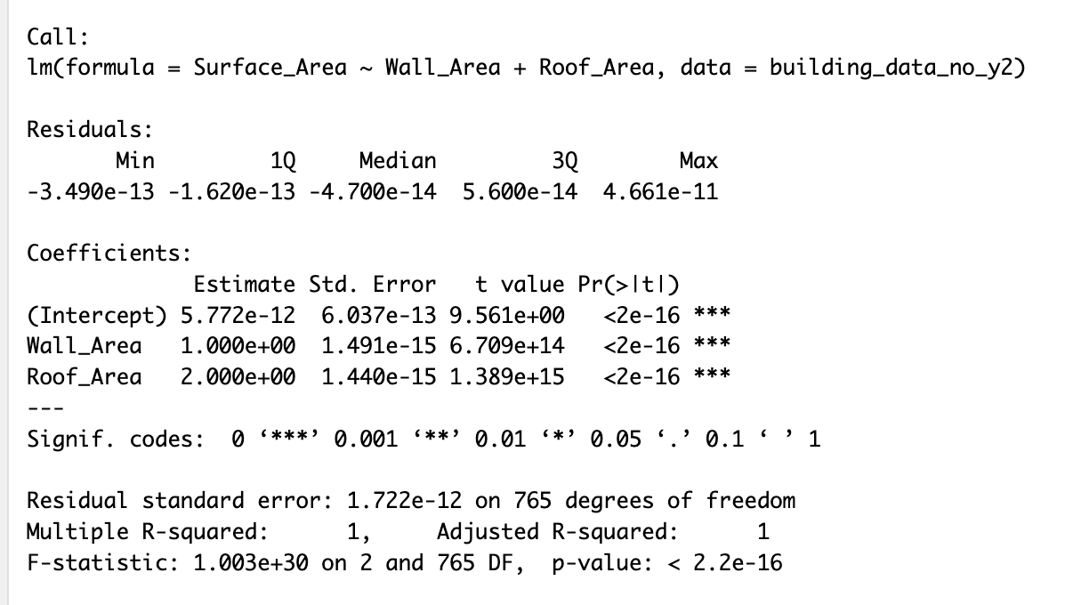
# Summary of a linear model for checking multicollinearity summary(lm(Surface_Area ~ Wall_Area + Roof_Area, data = building_data_no_y2))
REMOVING MULTICOLLINEARITY
The linear model summary for Surface_Area ~ Wall_Area + Roof_Area is used to check for multicollinearity in the dataset. Here's why this step is important:
Perfect Multicollinearity: The model shows a perfect linear relationship between Surface_Area and the combination of Wall_Area and Roof_Area.
R-squared = 1: The Multiple R-squared and Adjusted R-squared are both 1, indicating that 100% of the variance in Surface_Area is explained by Wall_Area and Roof_Area.
Extremely Low p-value: The F-statistic has an extremely low p-value (< 2.2e-16), suggesting a highly significant relationship.
Coefficient Interpretation: The coefficients show that Surface_Area = Wall_Area + 2 * Roof_Area, which is likely a geometric relationship in the building data.
Impact on Main Model: This perfect correlation explains why Roof_Area was excluded (NA) in the main Heating_Load model due to singularity.

Slide 13
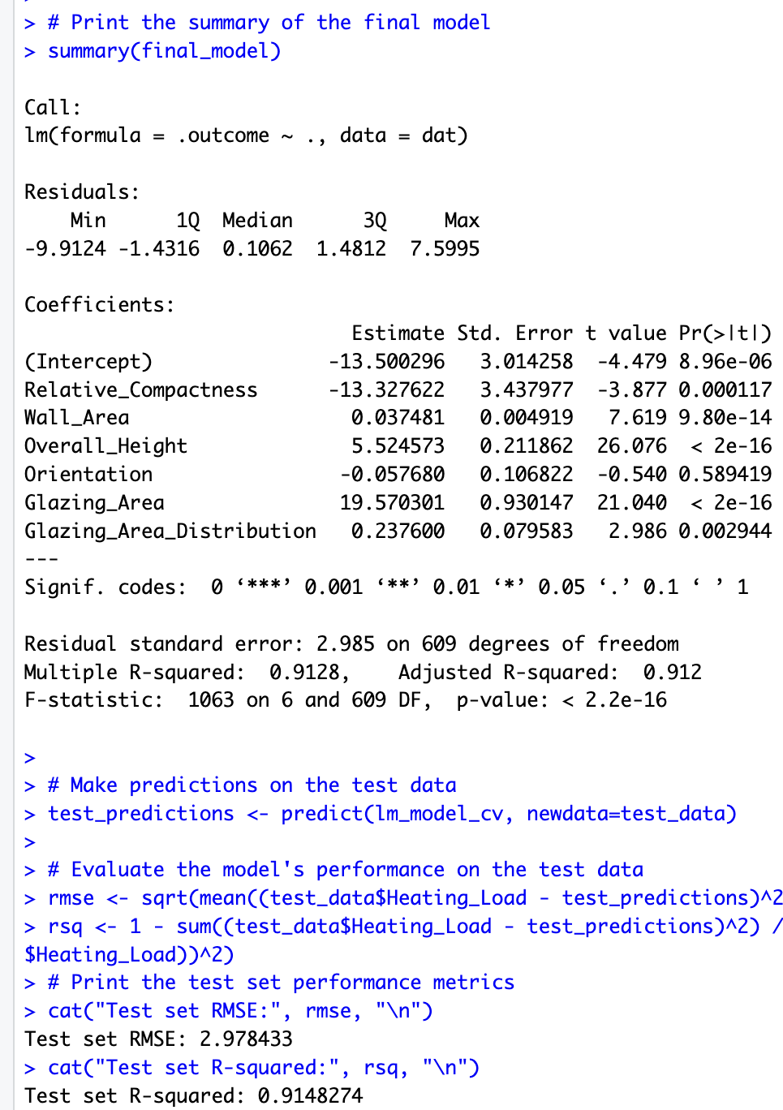
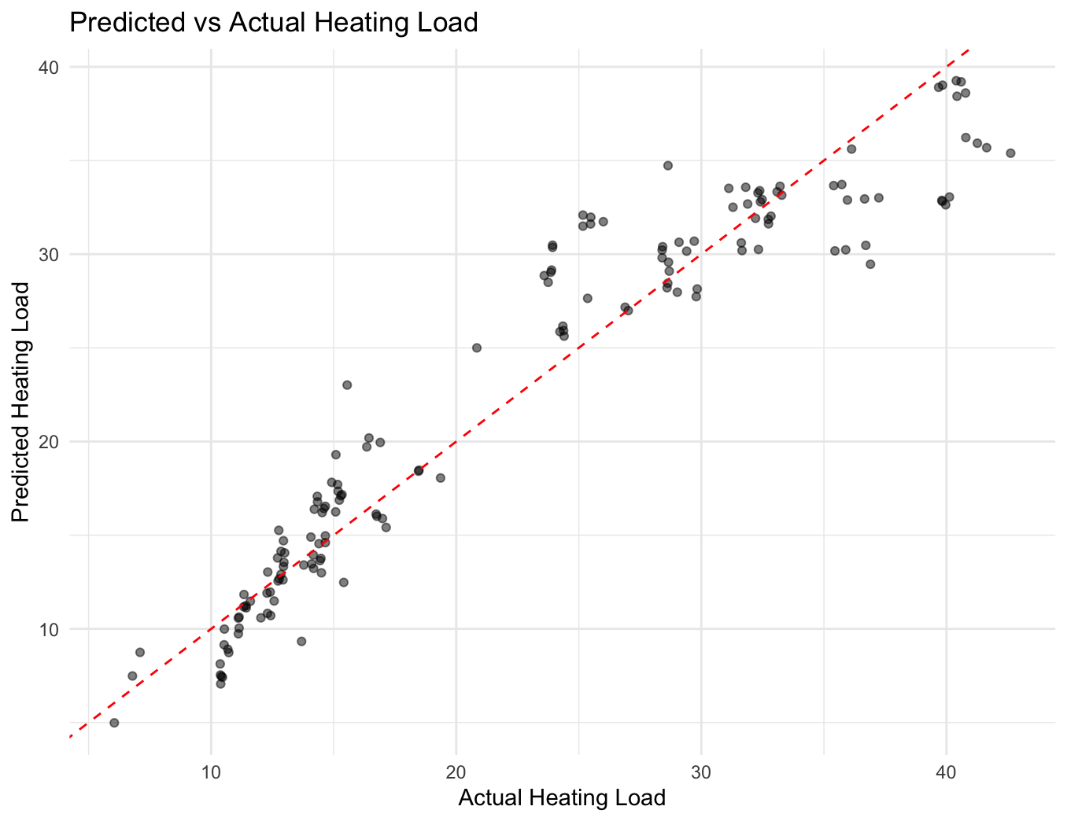
LINEAR REGRESSION MODEL SUMMARY

Slide 14

SIMPLE LINEAR REGRESSION
Model Development Steps
1. Data SplittingTraining set: 80% of data
Testing set: 20% of data
Random seed: 123
2. Cross-Validation SetupMethod: 10-fold cross-validation
Samples: 616
Predictors: 6
3. Model PerformanceCross-Validation Results:
RMSE: 2.97
R-squared: 0.913
MAE: 2.20
4. Final Model StatisticsMultiple R-squared: 0.913
Adjusted R-squared: 0.912
F-statistic: 1063 (p-value < 2.2e-16)
5. Test Set PerformanceRMSE: 2.98
R-squared: 0.915
6. Significant Predictors (p < 0.001):Overall Height (5.52)
Glazing Area (19.57)
Wall Area (0.037)
Relative Compactness (-13.33)

Slide 15

SUBSET SELECTION METHODS

Slide 16
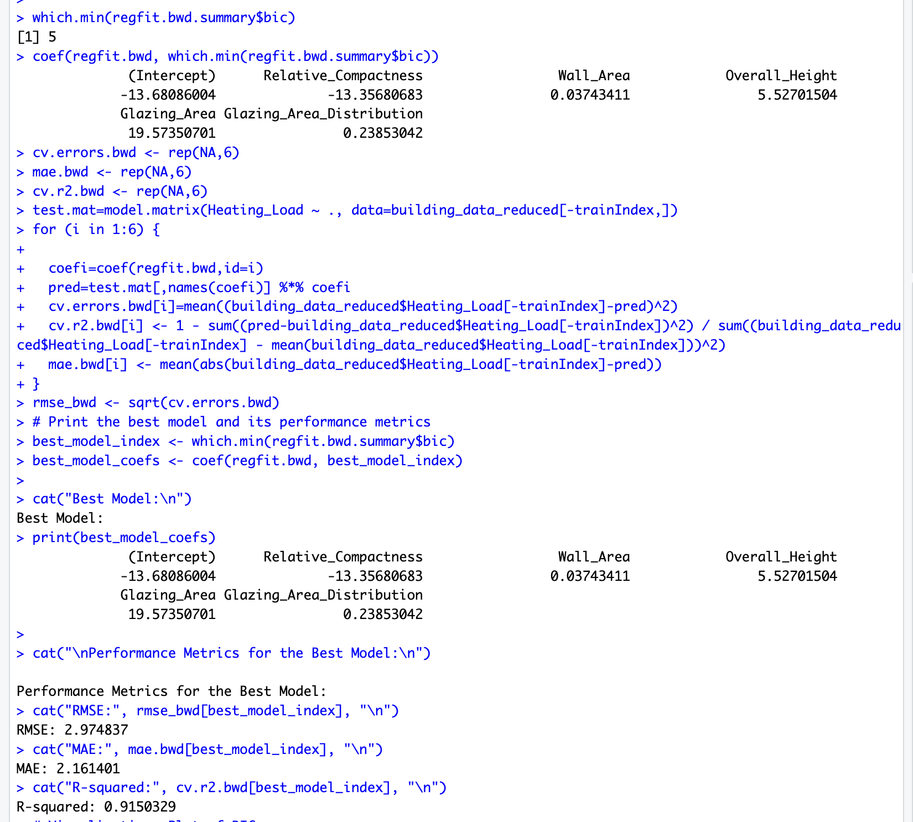
SELECTION ALGORITHM: BACKWARD
Backward Selection & Model Performance
1. Model Selection Process: Started with 6 predictors
Best Model (5 predictors):
Relative Compactness
Overall Height
Wall Area
Glazing Area
Glazing Area Distribution
2. Final Model Performance: RMSE: 2.97
MAE: 2.16
R-squared: 0.915
3. Key Insights: Overall Height shows strongest correlation with heating load
Orientation has no significant impact (excluded)
Model explains 91.5% of heating load variance
Cross-validation confirms model stability

Slide 17
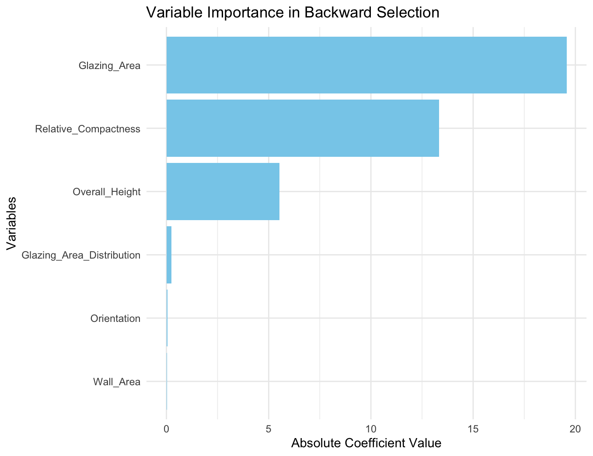
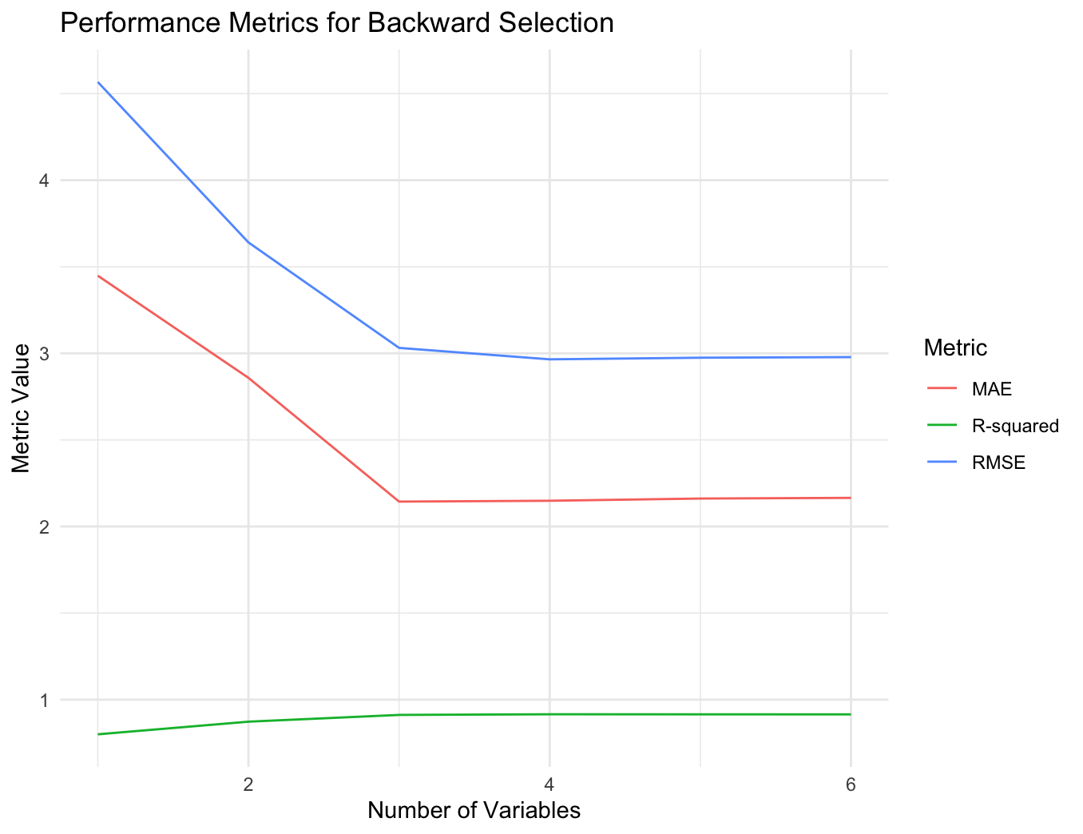
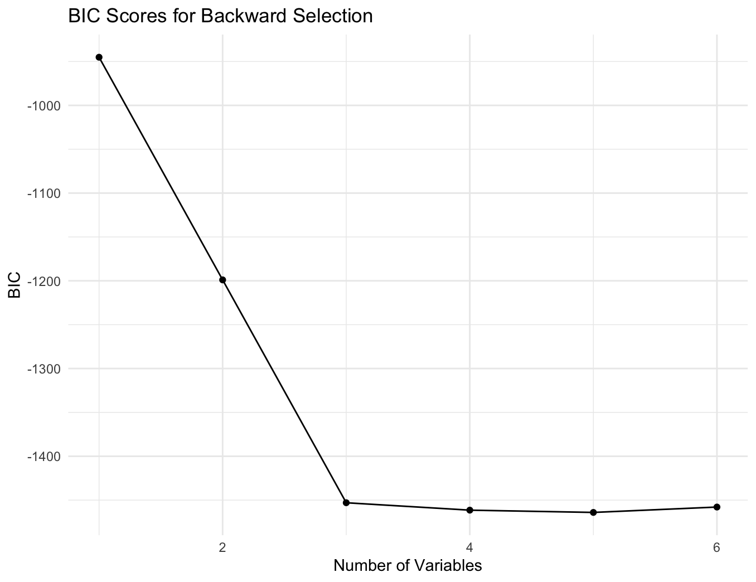
VISUALIZATIONS - BACKWARD

Slide 18
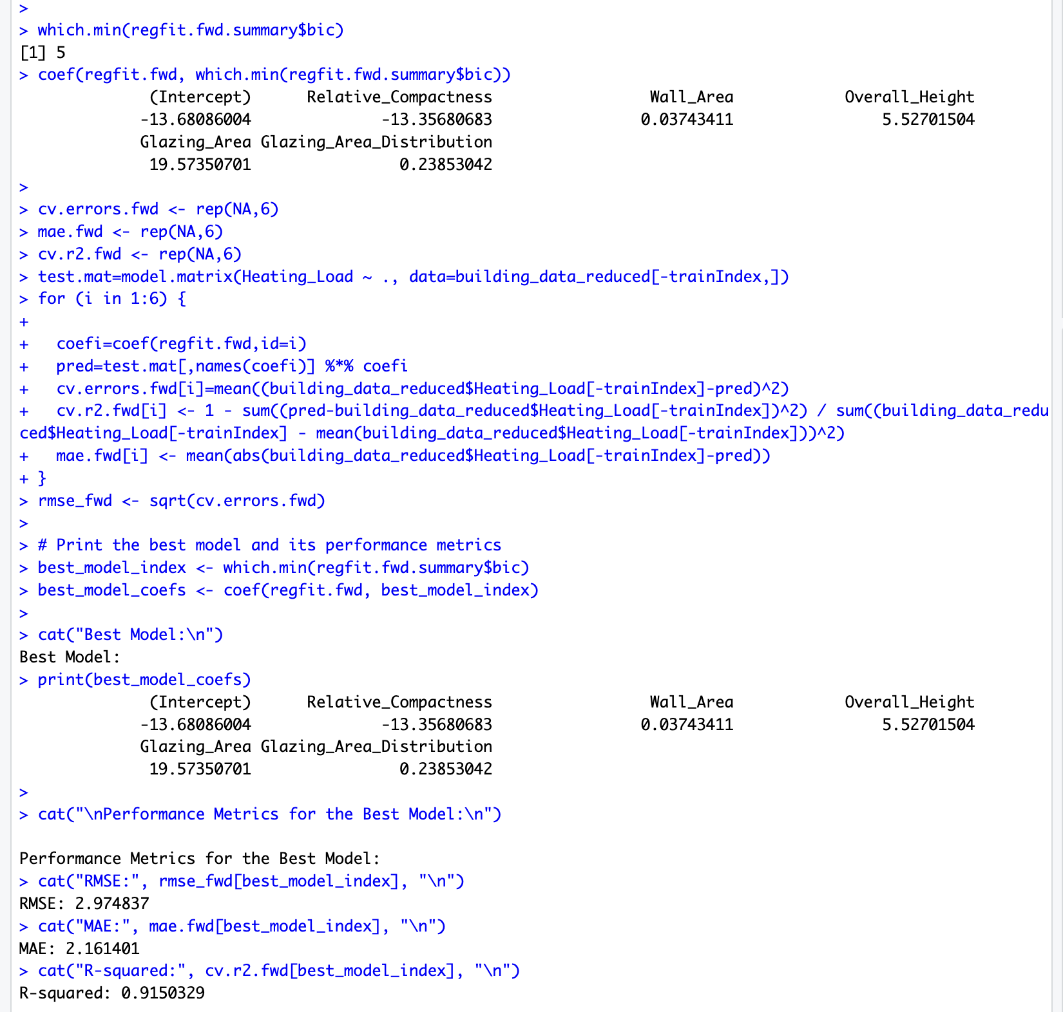
SELECTION ALGORITHM: FORWARD
Forward Selection & Model Performance
1. Model Building ProcessStarted with no predictors
Best Model (5 variables selected):Overall Height (strongest predictor)
Glazing Area
Wall Area
Relative Compactness
Glazing Area Distribution
2. Model Performance MetricsRMSE: 2.97
MAE: 2.16
R-squared: 0.915
3. Key FindingsModel explains 91.5% of heating load variance
Orientation excluded (no significant impact)
Cross-validation confirms model stability
Identical results to backward selection
This stepwise approach identified the most influential architectural features for predicting building heating load.

Slide 19

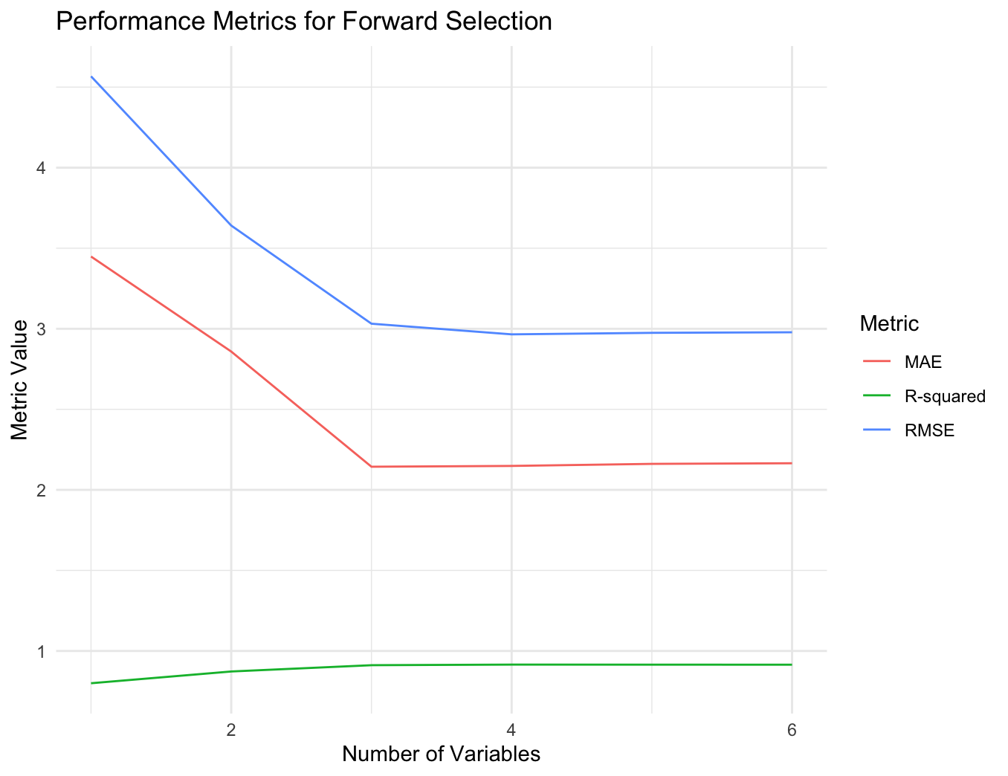
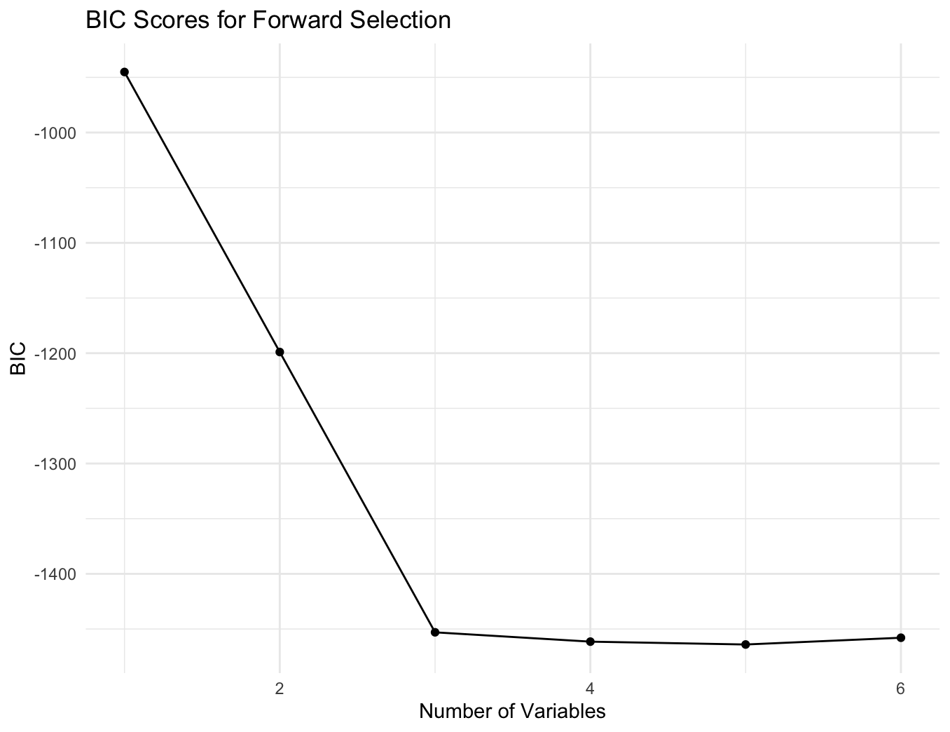
VISUALIZATIONS - FORWARD

Slide 20
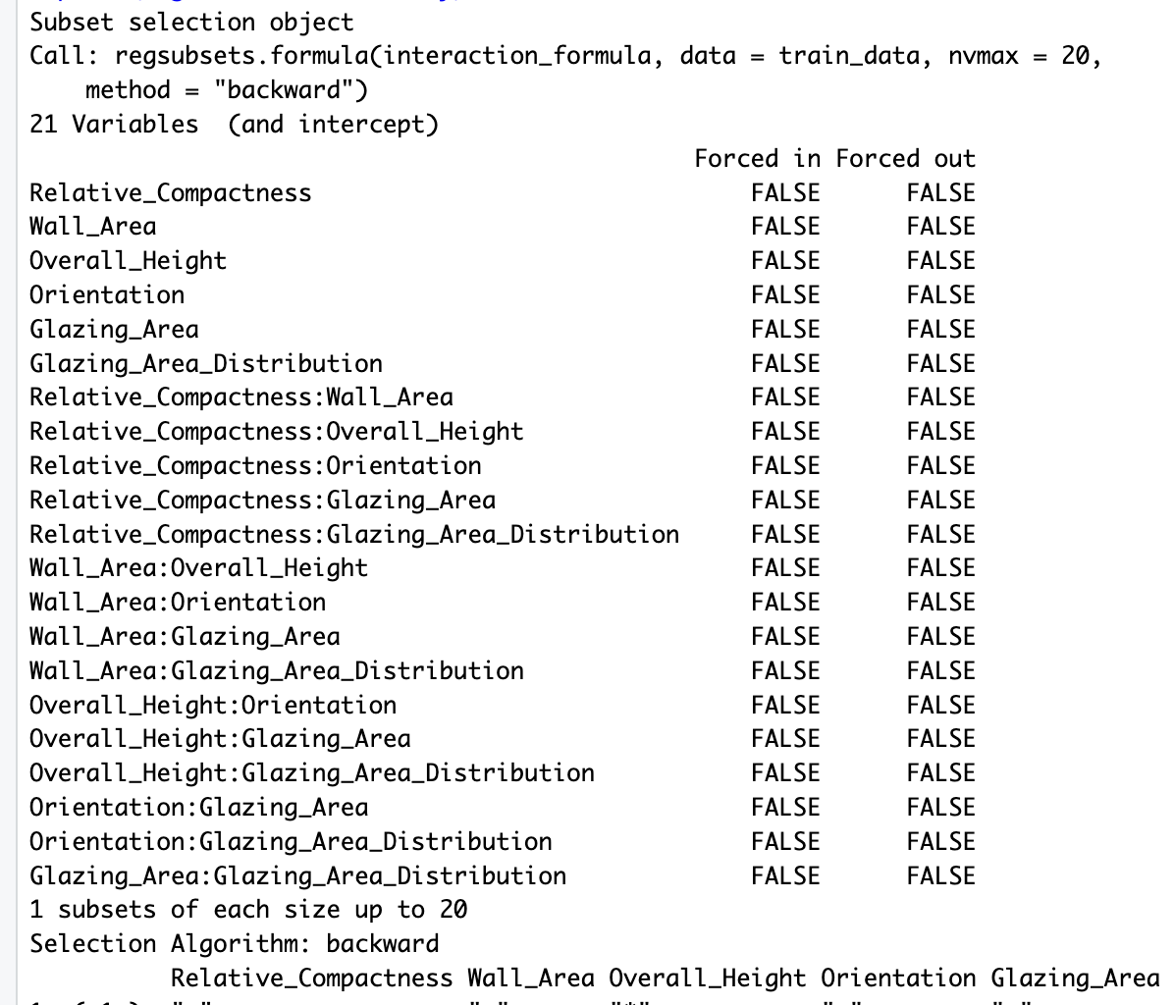
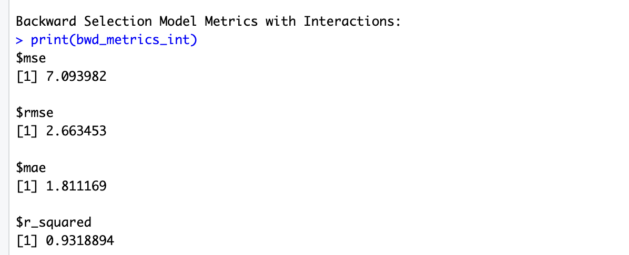
SELECTION ALGORITHM: BACKWARD SELECTION WITH INTERACTIONS

Slide 21
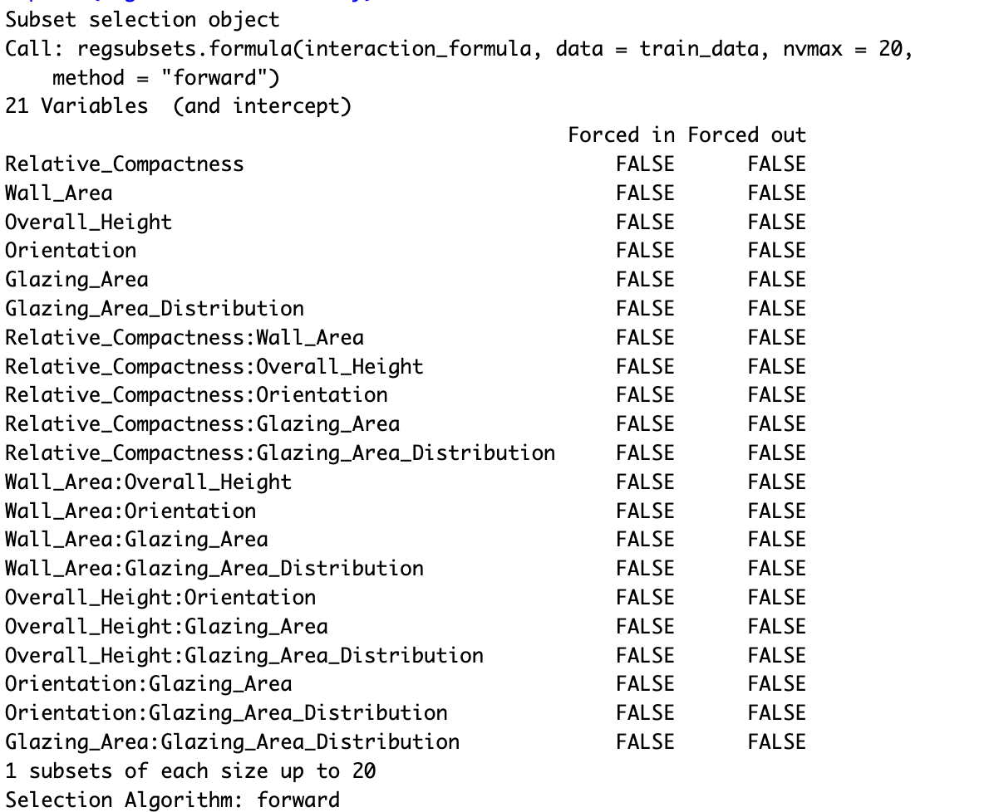
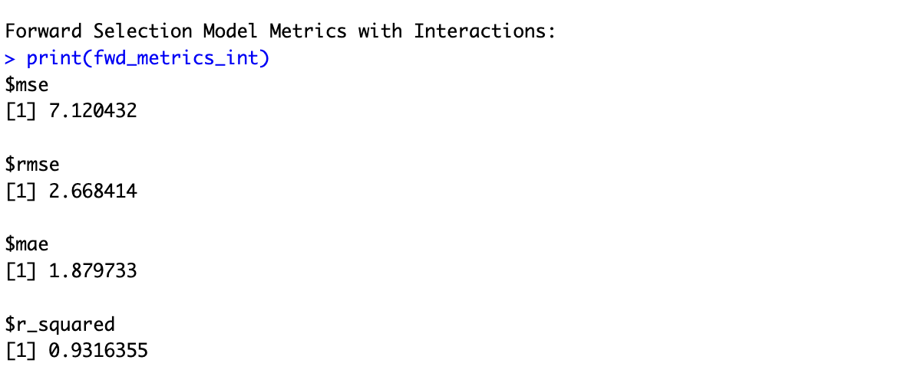
SELECTION ALGORITHM: FORWARD SELECTION WITH INTERACTIONS

Slide 22
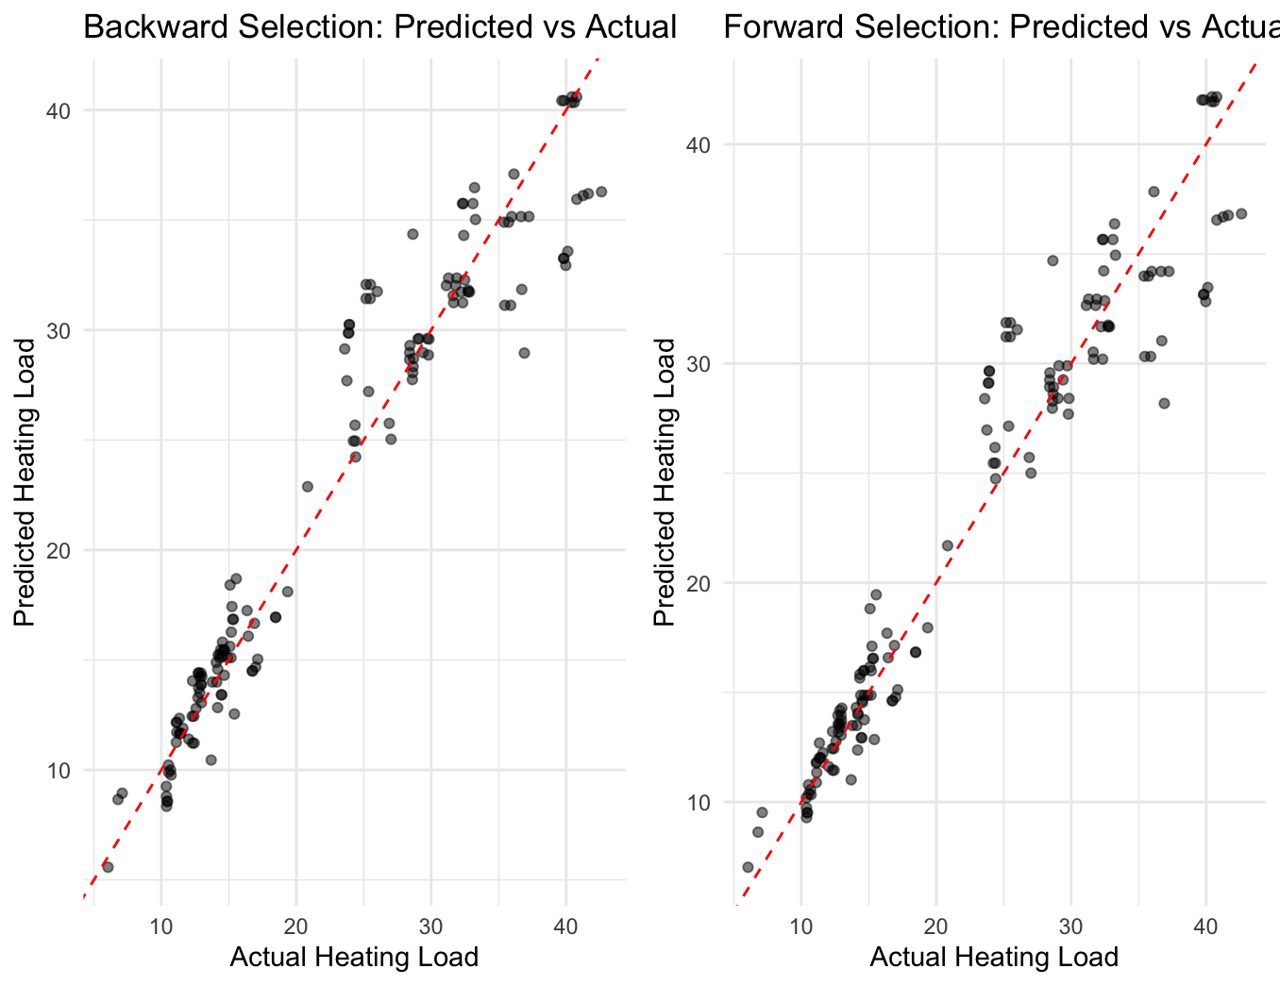
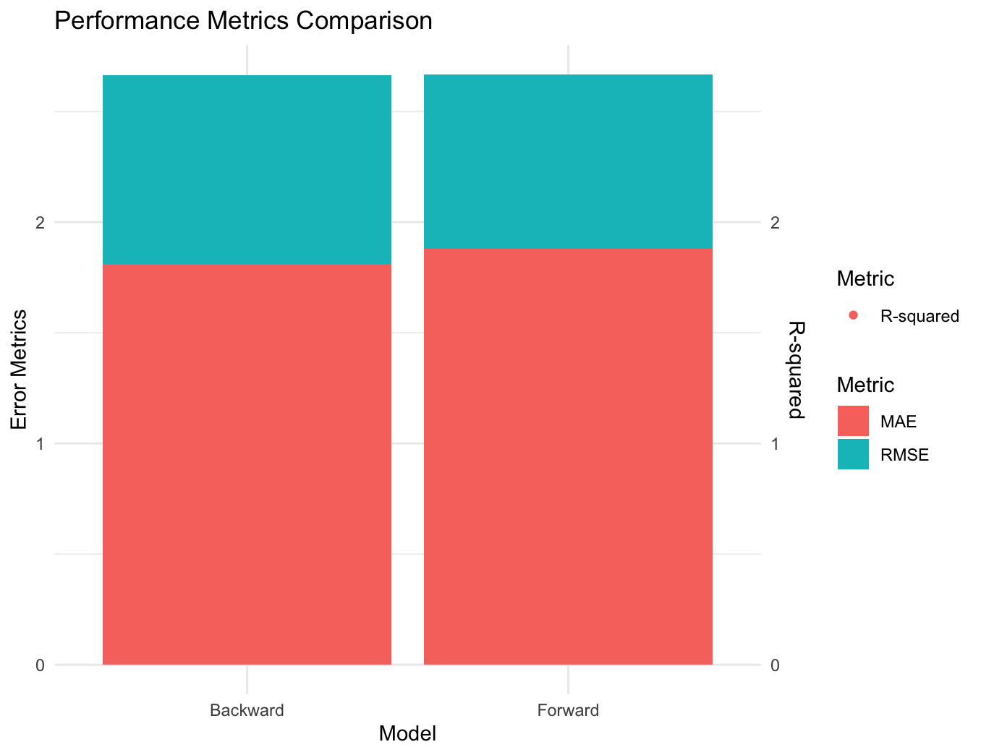
VISUALIZATIONS
Backward Selection with Interaction terms:
Data Points: The black dots represent individual data points where the predicted heating load is plotted against the actual heating load.
Trend: The overall trend is positive, indicating that as the actual heating load increases, the predicted heating load also tends to increase.
Accuracy: The points are relatively close to the red dashed line (ideal fit), suggesting that Backward Selection provides reasonably
accurate predictions.
Forward Selection with Interaction terms :
Data Points: Similar to Backward Selection, black dots show individual data points.
Trend: Again, a positive trend is observed.
Accuracy: The points are slightly more scattered than in Backward Selection, indicating a less accurate prediction.

Slide 23
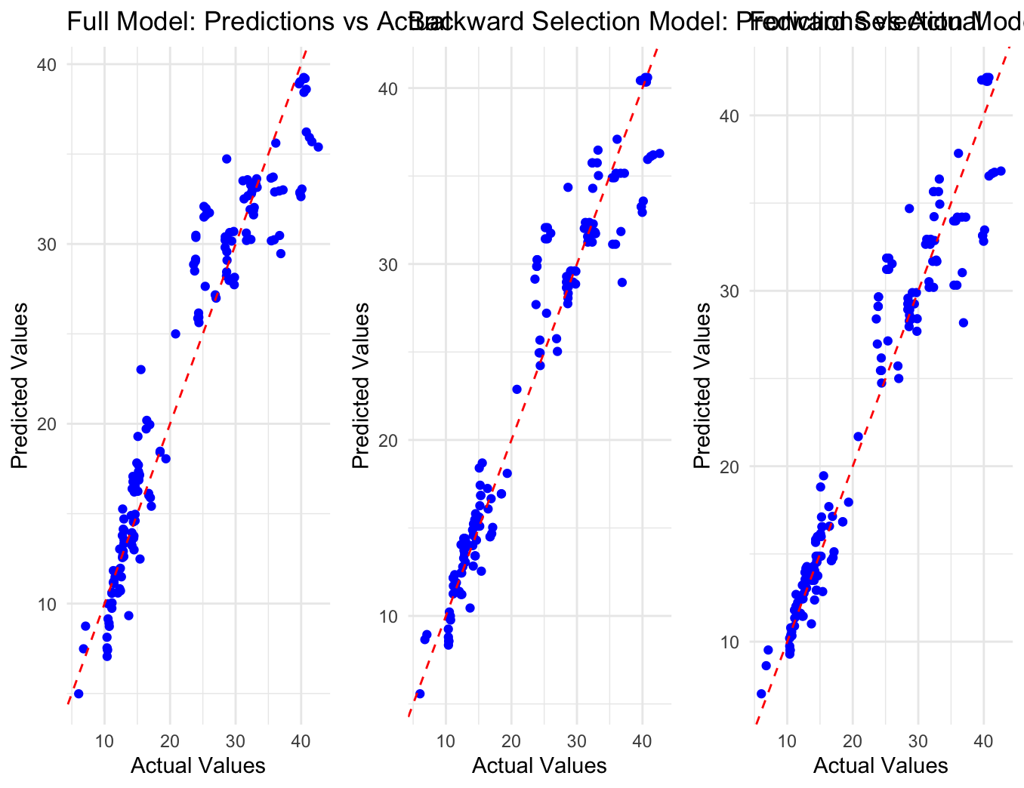
RESULTS
Model | RMSE | R-Squared | Interpretation
Full Model | 2.978433 | 0.9148274 | Highest RMSE, lowest R-squared, may be overfitting
Backward Selection (Interactions) | 2.663453 | 0.9318894 | Best performance, lowest RMSE, highest R-squared
Forward Selection (Interactions) | 2.668414 | 0.9316355 | Second-best performance

Slide 24

DISCUSSION
Performance of Advanced Models for Heating Load Prediction
Backward Selection Model with Interactions
Best overall performance
Lowest RMSE: 2.663453
Highest R-squared: 0.9318894 (93.19% variance explained)
Forward Selection Model with Interactions
Second-best performance
RMSE: 2.668414
R-squared: 0.9316355 (93.16% variance explained)
Full Model
Poorest performance
Highest RMSE: 2.978433
Lowest R-squared: 0.9148274 (91.48% variance explained)
Key Insights
Advanced models outperform the Full Model
Interaction terms significantly improve predictions
Variable selection methods identify crucial predictors
Backward Selection Model offers the best balance of accuracy and parsimony

Slide 25
CONCLUSION
Conclusion: Predicting Building Heating Load
Summary of Findings
Complex building energy consumption patterns require models that capture intricate relationships.
Advanced models (Backward and Forward Selection with Interactions) excel in accuracy.
Outstanding Model Performance
Backward Selection Model with Interactions: Lowest RMSE (2.663453), Highest R-squared (0.9318894).
Forward Selection Model with Interactions: RMSE (2.668414), R-squared (0.9316355).
Comparative Analysis
Full Model serves as a baseline but lacks effectiveness in capturing complex relationships.
Interaction terms significantly enhance model performance.
Implications for Energy Efficiency
Accurate heating load predictions optimize design and energy conservation.
Insights inform policy and strategic planning in construction.
Summary
Advanced statistical modeling is crucial for sustainable development, emphasizing the role of interaction terms in extracting insights from complex datasets.

